Slide 1
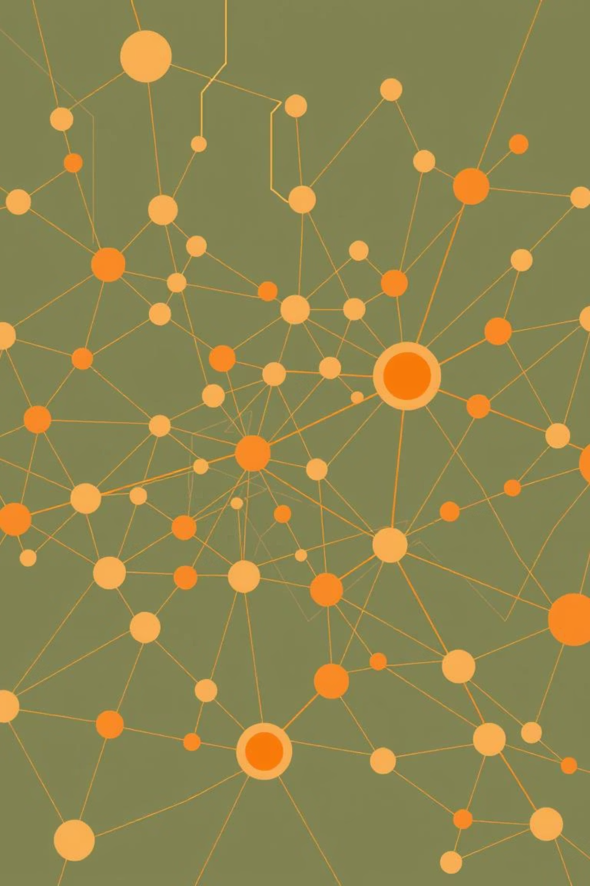
From Raw Data to Semantic Graphs: The Pipeline of Knowledge Extraction
MileStone-3

Slide 2


Step 1: Data Collection & Preprocessing
The data collection being the first step of the complete process gives the model the data it needs to work on and produce the results according to them. The gathered Data contains multiple categories like Famous scientists, Scientific theories, Important historical events, Classic literature works, Notable places, Prestigious institution. But at the start, all of the data might contain many abnormalities and mistakes which might make the model to produce the wrong output.
To avoid all the problems from the uncleaned dataset it is pre-processed and cleansed by taking the necessary steps.
Collect Raw Data
Cleanse & Normalize
Real-world Impact
Gather information from diverse sources, including medical records, scientific articles, and social media feeds.
Preprocessing steps involve removing noise, tokenization, lowercasing, and handling abbreviations to prepare text for analysis.
Digitized clinical notes in Electronic Health Records (EHRs) exemplify how this initial step enables scalable automated analysis. [ScienceDirect 2023]

Slide 3

Step 2: Named Entity Recognition (NER)
NLP task to identify and classify real-world entities in text (e.g., person, place, organization, date).
Working:
Step 1: Detect entity words/phrases.
Step 2: Classify into categories (Person, Location, Organization, etc.).
Uses ML, Deep Learning, and Transformer models.
Identify Key Entities
Advanced Recognition
Navigating Complexities
NER accurately pinpoints and categorizes crucial entities like people, organizations, diseases, and drugs within textual data.
Modern NER leverages sophisticated deep learning models such as BERT and BiLSTM, enhancing contextual understanding.
Biomedical NER faces unique challenges, including ambiguous terms, synonyms, and multi-word entities (e.g., "Alice in Wonderland syndrome").
For instance, an NER system can extract "Steve Jobs" as a Person and "Apple" as an Organization from a given text.

Slide 4
Step 3: Relation Extraction (RE)
Definition:
NLP task of identifying semantic relationships between entities in text.
Working:
NER Output: First detect entities.
Relation Detection: Check if a meaningful relation exists.
Relation Classification: Assign relation type (e.g., works for, located in).
Semantic Connections
Diverse Methodologies
Structured Knowledge
RE identifies the meaningful relationships between entities, for example, recognizing "Steve Jobs" co-founded "Apple".
Techniques range from dependency parsing to advanced neural models and reinforcement learning methods.
RE is crucial for transforming unstructured text into structured knowledge, vital for sectors like healthcare and finance.

Slide 5
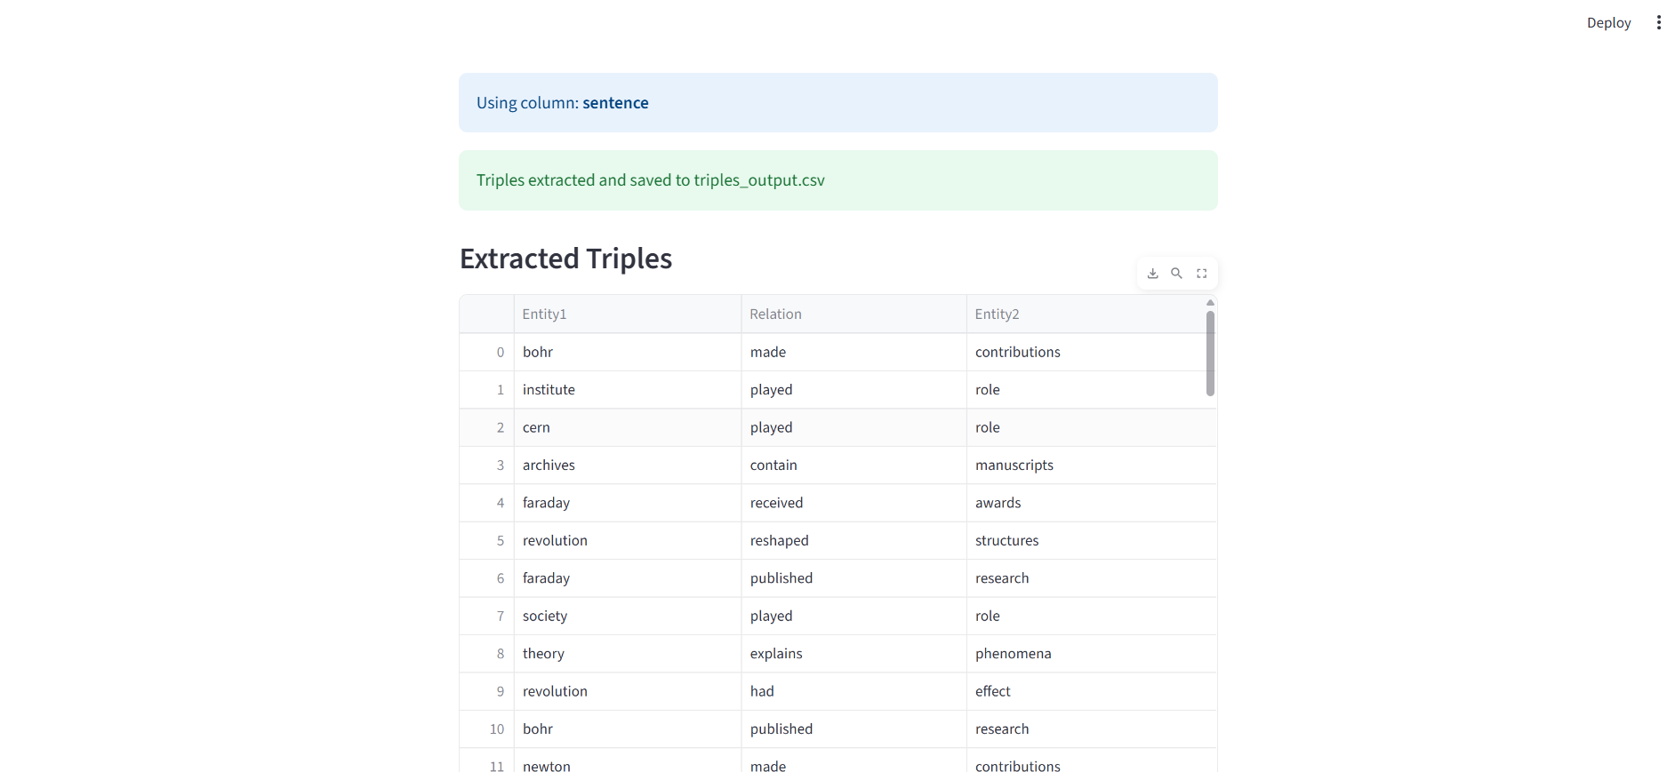
Output of extraction:

Slide 6
Step 4: Constructing Semantic Graphs
In this final stage, identified entities become nodes within a knowledge graph (KG), and the extracted relations form the edges.
Working:
Input: Entities (from NER) + Relations (from RE).
Nodes: Represent entities (e.g., Person, Organization, Location).
Edges: Represent semantic relations (e.g., works_for, located_in).
Output: Graph structure = Knowledge Graph.
Knowledge graphs enable rich querying, inference, and visualization of complex interconnections.
Visualization tools provide interactive ways to explore and analyze these powerful semantic networks.

Slide 7
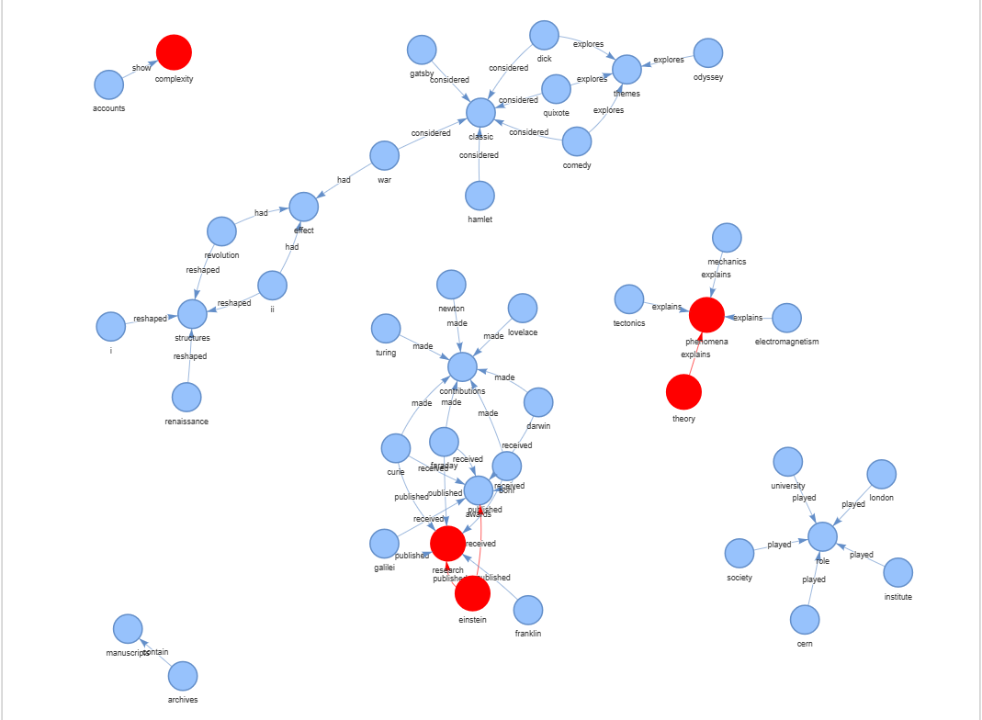
Produced Semantic graph:

Slide 8
Conclusion:
Data Collection and Preprocessing
1
Done by SaiTejaswi. The data collected and pre-processed is based on multiple fields like Scientists name, historical events etc.
The pre processing includes removing/deleting unwanted data, fixing spaces, conversion to lowercase etc.
Named Entity Recognition
2
Done by Poobeshraj. The NER helps by categorising the entities into their specific categories like name, place, organization etc.
This was applied in the code for easy segregation of the data and understanding it for its better usage.
Semantic Map
3
Done by Jahnavi. It included Relation Extraction and Construction of the Semantic graphs which helps with better understanding
and better presentation and accuracy of the data. It visualizes the processed data according to the relations formed among them.
Overall
4
The overall conclusion of this Project/Milestone is creating and producing a cleaned dataset by following a pipeline of preprocessing,
NER, RE, and sematic graphs which reduces the time taken while using the tradional methods and visualizing them in a better format.

